Slide 2
Language Department
Topic: Adverbs of frequency
Teacher: LG Michelle Miguez Gutiérrez
July –December 2015

Slide 3

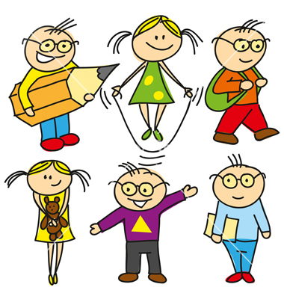

Slide 4
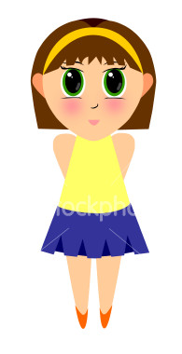
We use frequency adverbs to describe how often we do an activity
always
usually
often
sometimes
rarely
never
Verb (eat, play, study, sleep, etc.)
Denisse usually plays the guitar
She never eats sushi

Slide 5
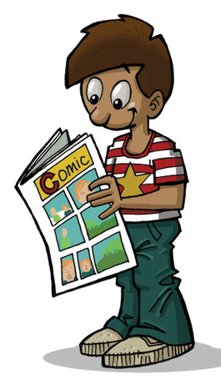
I read the newspaper everyday.
Mon | Tue | Wed | Thu | Fri | Sat | Sun
 | 1 | 2 | 3 | 4 | 5 | 6
7 | 8 | 9 | 10 | 11 | 12 | 13
14 | 15 | 16 | 17 | 18 | 19 | 20
21 | 22 | 23 | 24 | 25 | 26 | 27
28 | 29 | 30 | 31

Slide 6
I always read a book.
Mon | Tue | Wed | Thu | Fri | Sat | Sun
 | 1 | 2 | 3 | 4 | 5 | 6
7 | 8 | 9 | 10 | 11 | 12 | 13
14 | 15 | 16 | 17 | 18 | 19 | 20
21 | 22 | 23 | 24 | 25 | 26 | 27
28 | 29 | 30 | 31

Slide 7
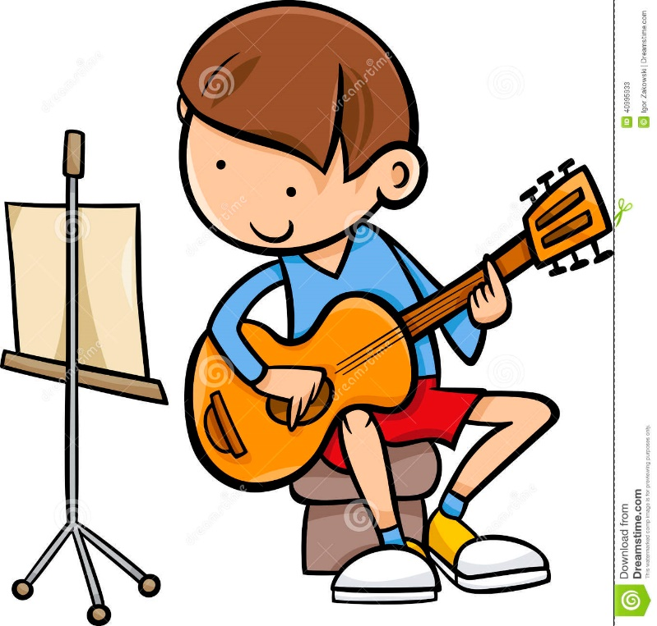
I play the guitar
five times a week.
Mon | Tue | Wed | Thu | Fri | Sat | Sun
 | 1 | 2 | 3 | 4 | 5 | 6
7 | 8 | 9 | 10 | 11 | 12 | 13
14 | 15 | 16 | 17 | 18 | 19 | 20
21 | 22 | 23 | 24 | 25 | 26 | 27
28 | 29 | 30 | 31

Slide 8
I usually play the guitar.
Mon | Tue | Wed | Thu | Fri | Sat | Sun
 | 1 | 2 | 3 | 4 | 5 | 6
7 | 8 | 9 | 10 | 11 | 12 | 13
14 | 15 | 16 | 17 | 18 | 19 | 20
21 | 22 | 23 | 24 | 25 | 26 | 27
28 | 29 | 30 | 31

Slide 9
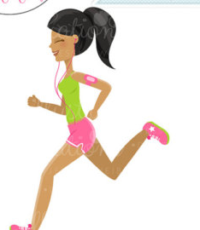
I run
twice a week.
Mon | Tue | Wed | Thu | Fri | Sat | Sun
 | 1 | 2 | 3 | 4 | 5 | 6
7 | 8 | 9 | 10 | 11 | 12 | 13
14 | 15 | 16 | 17 | 18 | 19 | 20
21 | 22 | 23 | 24 | 25 | 26 | 27
28 | 29 | 30 | 31

Slide 10
I often run.
Mon | Tue | Wed | Thu | Fri | Sat | Sun
 | 1 | 2 | 3 | 4 | 5 | 6
7 | 8 | 9 | 10 | 11 | 12 | 13
14 | 15 | 16 | 17 | 18 | 19 | 20
21 | 22 | 23 | 24 | 25 | 26 | 27
28 | 29 | 30 | 31

Slide 11
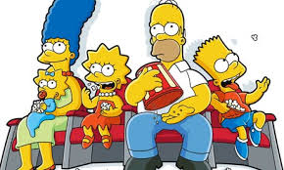
I go to the cinema once a week.
Mon | Tue | Wed | Thu | Fri | Sat | Sun
 | 1 | 2 | 3 | 4 | 5 | 6
7 | 8 | 9 | 10 | 11 | 12 | 13
14 | 15 | 16 | 17 | 18 | 19 | 20
21 | 22 | 23 | 24 | 25 | 26 | 27
28 | 29 | 30 | 31

Slide 12
I sometimes go to the cinema.
Mon | Tue | Wed | Thu | Fri | Sat | Sun
 | 1 | 2 | 3 | 4 | 5 | 6
7 | 8 | 9 | 10 | 11 | 12 | 13
14 | 15 | 16 | 17 | 18 | 19 | 20
21 | 22 | 23 | 24 | 25 | 26 | 27
28 | 29 | 30 | 31

Slide 13
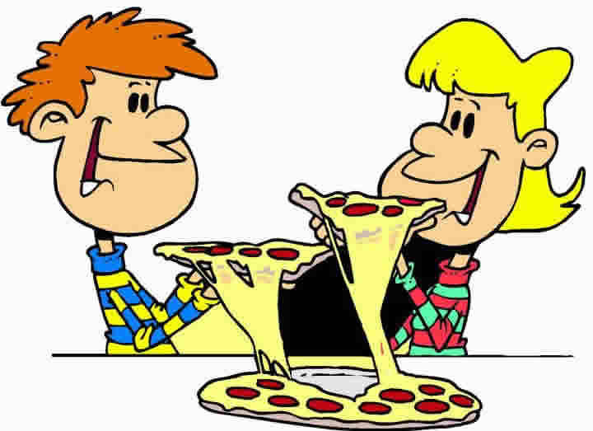
I go to the cinema once a month.
Mon | Tue | Wed | Thu | Fri | Sat | Sun
 | 1 | 2 | 3 | 4 | 5 | 6
7 | 8 | 9 | 10 | 11 | 12 | 13
14 | 15 | 16 | 17 | 18 | 19 | 20
21 | 22 | 23 | 24 | 25 | 26 | 27
28 | 29 | 30 | 31

Slide 14
I rarely go to the cinema.
Mon | Tue | Wed | Thu | Fri | Sat | Sun
 | 1 | 2 | 3 | 4 | 5 | 6
7 | 8 | 9 | 10 | 11 | 12 | 13
14 | 15 | 16 | 17 | 18 | 19 | 20
21 | 22 | 23 | 24 | 25 | 26 | 27
28 | 29 | 30 | 31

Slide 15
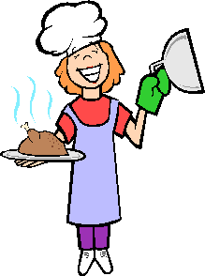
I don’t cook the dinner.
Mon | Tue | Wed | Thu | Fri | Sat | Sun
 | 1 | 2 | 3 | 4 | 5 | 6
7 | 8 | 9 | 10 | 11 | 12 | 13
14 | 15 | 16 | 17 | 18 | 19 | 20
21 | 22 | 23 | 24 | 25 | 26 | 27
28 | 29 | 30 | 31

Slide 16
I never cook the dinner.
Mon | Tue | Wed | Thu | Fri | Sat | Sun
 | 1 | 2 | 3 | 4 | 5 | 6
7 | 8 | 9 | 10 | 11 | 12 | 13
14 | 15 | 16 | 17 | 18 | 19 | 20
21 | 22 | 23 | 24 | 25 | 26 | 27
28 | 29 | 30 | 31

Slide 17
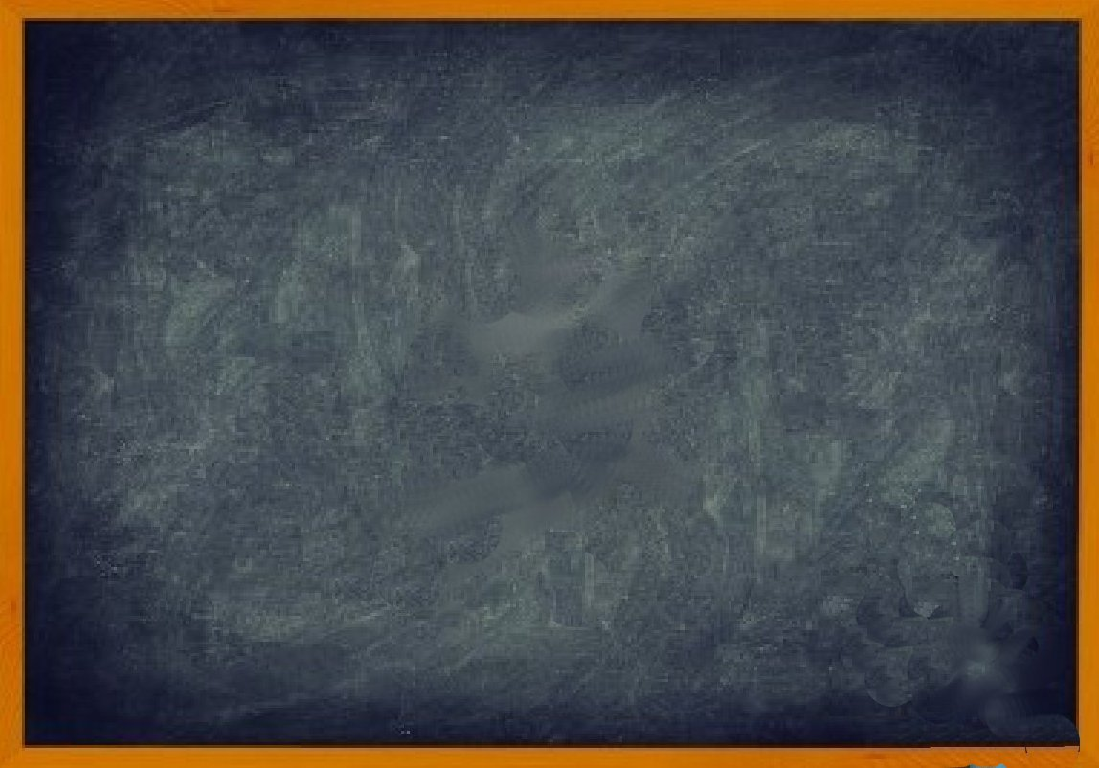
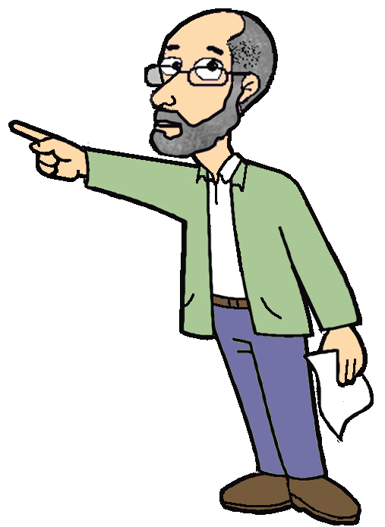
0 %
100 %
Remember
always
usually
often
sometimes
rarely
never

Slide 18
Remember
once
twice
three times
four times
five times
1 | 2 | 3 | 4 | 5
1 | 2 | 3 | 4 | 5
1 | 2 | 3 | 4 | 5
1 | 2 | 3 | 4 | 5
1 | 2 | 3 | 4 | 5

