Slide 1


UNIVERSIDAD AUTÓNOMA DEL ESTADO DE HIDALGO
ESCUELA SUPERIOR DE ZIMAPÁN
Licenciatura en Contaduría
Eventos pasados y futuros. Lengua Extranjera.
L.E.L.I. Paulina Trujillo Castillo
Julio – Diciembre 2016

Slide 2
Resumen (Abstract)
La siguiente presentación muestra algunos ejemplos de biografías y un plan base que puede ser utilizado cuando queremos escribir una biografía por nosotros mismos.
(The following presentation shows some examples about biographies and later a base plan which can be used anytime we eant to write a biography on our own.)

Slide 3
Palabras clave (Keywords):
Past simple verbs, linking words.
Verbos en tiempo pasado, conectores.

Slide 4
Objetivo general:
El alumno será capaz de proporcionar y solicitar información básica de manera escrita y oral acerca de acciones y actividades que indiquen posibles eventos en el futuro, intenciones, posibles planes y promesas.

Slide 5
Nombre de la unidad:
2. Eventos pasados
Objetivo de la unidad:
Describir sucesos y eventos pasados en un discurso oral y escrito en contextos familiares o de su entorno inmediato en una segunda lengua.

Slide 6
Tema:
2.1. Hablar de eventos pasados.

Slide 7

Desarrollo del Tema:
According to its definition, a biography is a written account of another person's life, and it can be written about death people or sometimes it can be done as a profile by taking in consideration the most important events in the person’s life.

Slide 8
The following slides show some examples about different kind of biographies.

Slide 9
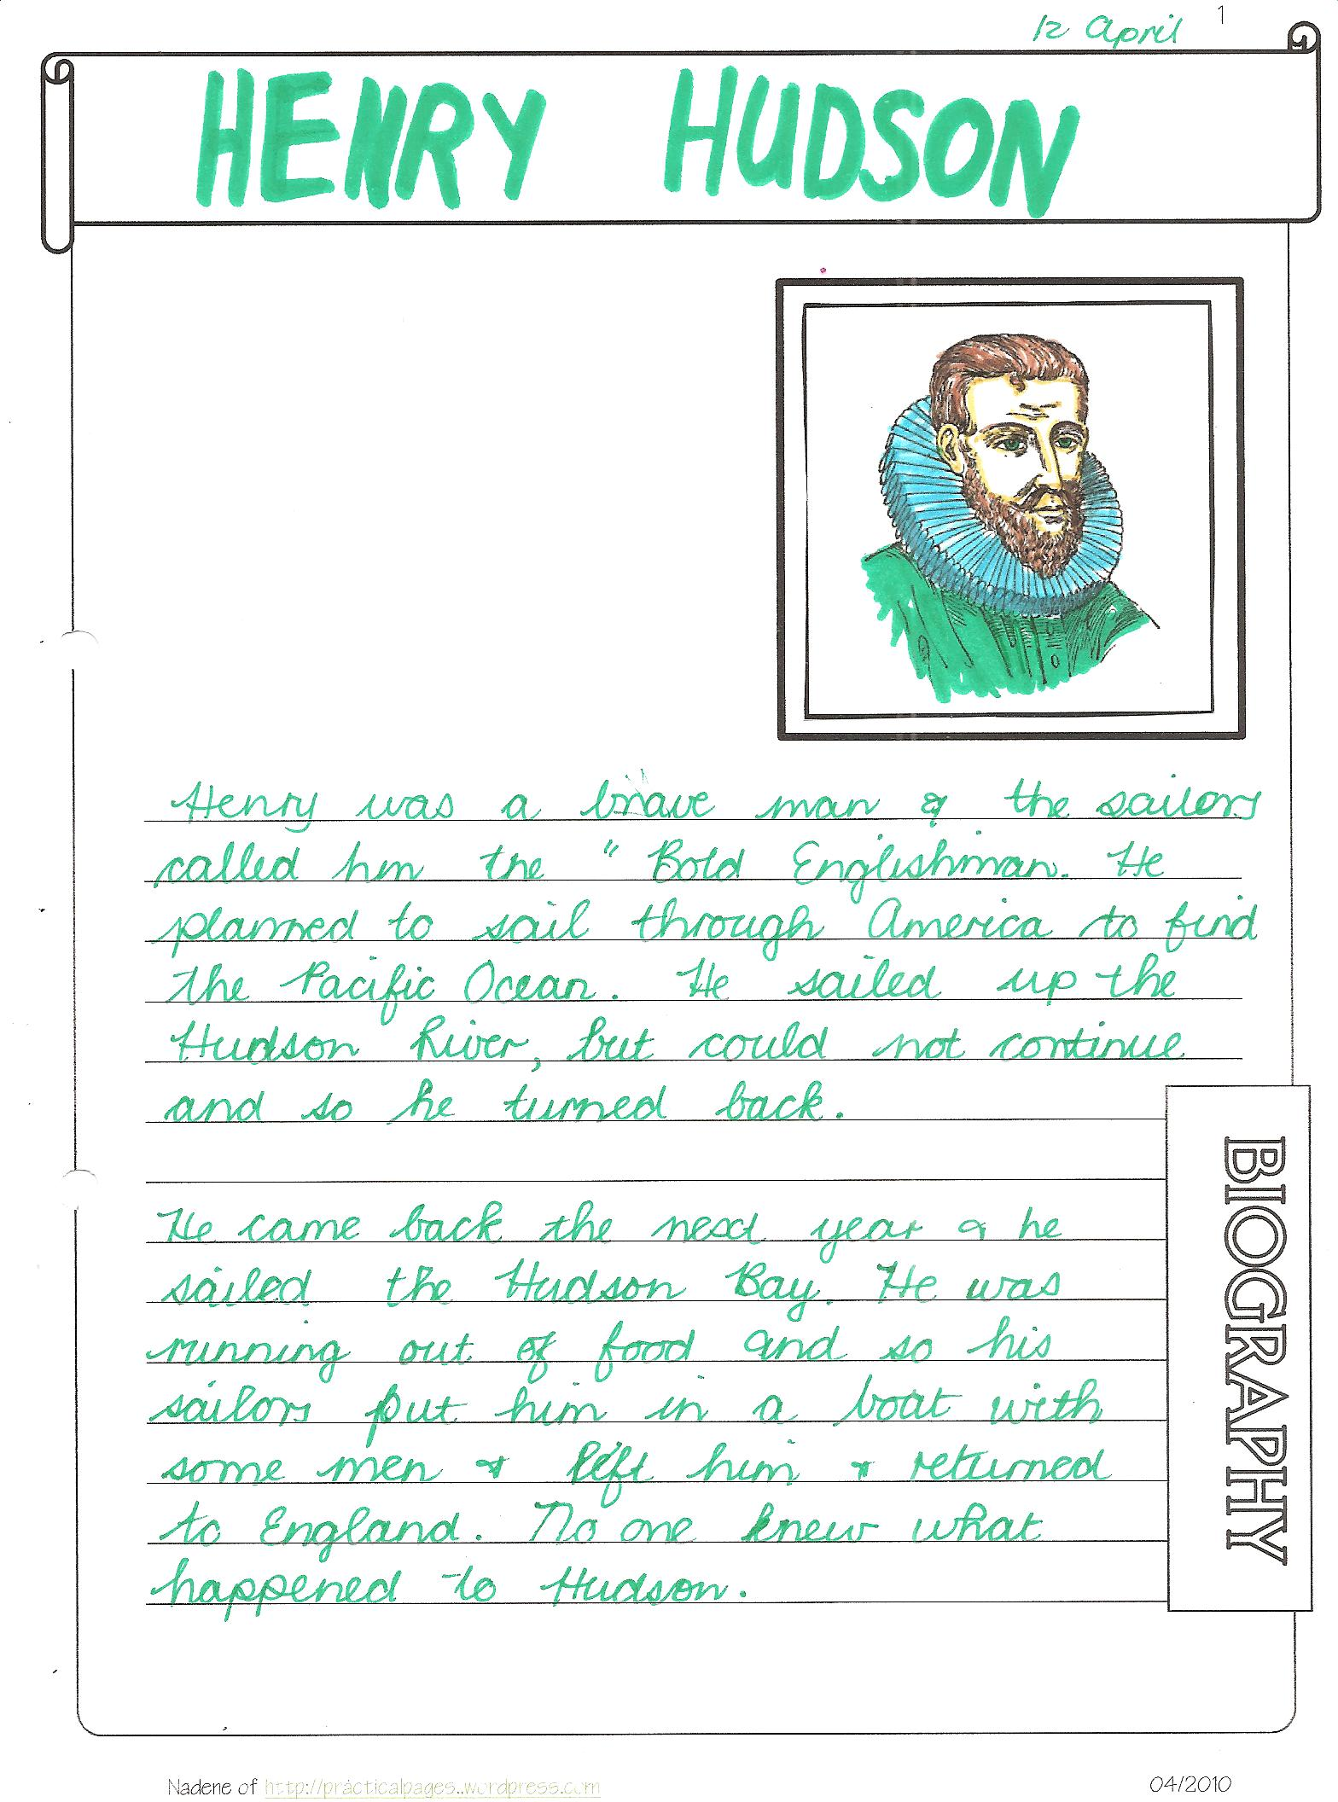

Slide 10
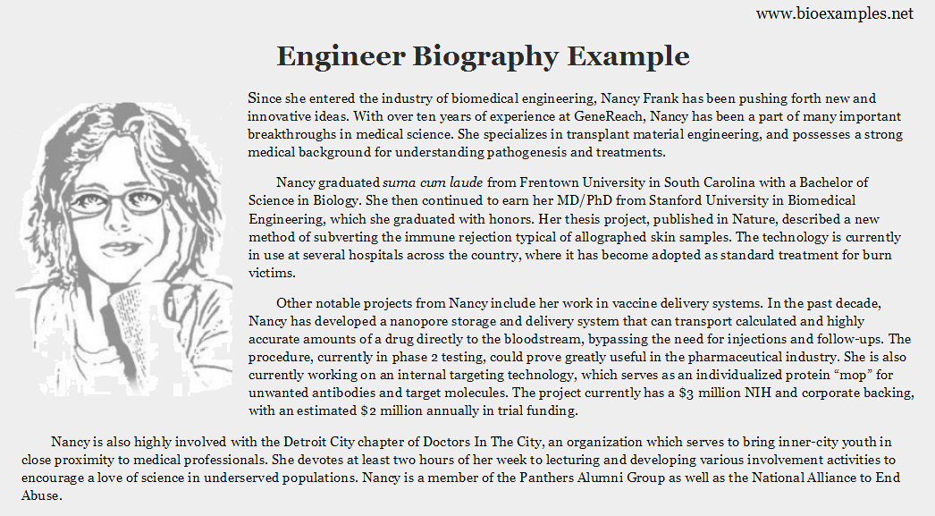

Slide 11
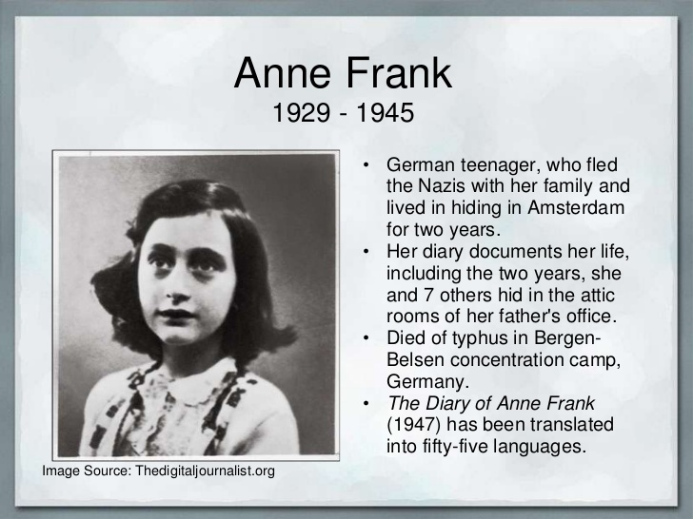

Slide 12
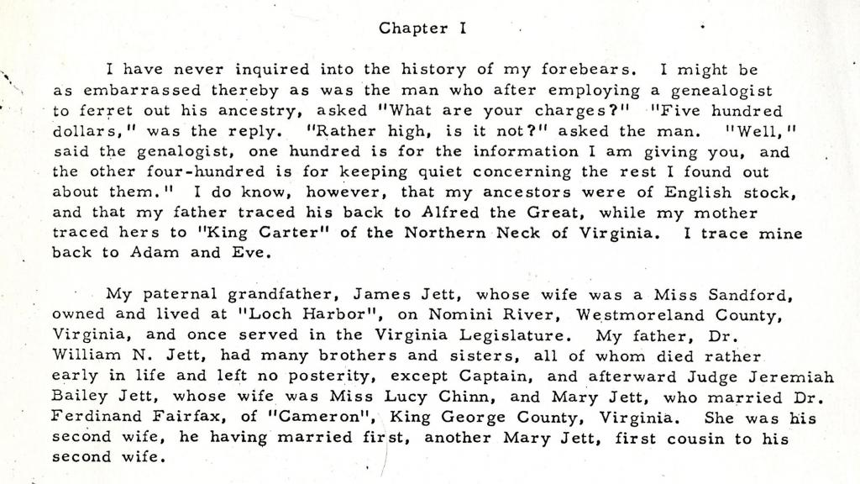


Slide 13

If you want to write a biography, you can follow the next plan:

Slide 14
When we write a biography about a person who has died, we start with the person’s full name, what he/ she is famous for and date and place he /she was born. We then write about the important events/ achievements in his/ her early and later years in chronological order. We end the biography with when and where he/ she died.
We use past tenses.

Slide 15

Plan
Paragraph 1: full name, what he is famous for, date/ place of birth.
Paragraph 2: important dates in his life in chronological order – early years/ later years.
Paragraph 3: about his death.

Slide 16
Referencias bibliográficas:
Paul Davies, M. G. (2014). Make it Real! Professional. Mexico: Universidad Autónoma del Estado Hidalgo.
Redston, C. Cunningham, G. (2005). Face2Face ElementaryTeacher’s Book. Cambridge, London. Cambridge University Press.
Redston, C. Cunningham, G. (2005). Face2Face ElementaryWorkbook. Cambridge, London. Cambridge University Press.
Evans, V. Dooley, J. (2002).Enterprise Coursebook 1.Newbury, Berkshire. Express Publishing.
Evans, V. Dooley, J. (2002).Enterprise Workbook 1.Newbury, Berkshire. Express Publishing.
Evans, V. Dooley, J. (2002).Enterprise Grammar Book 1.Newbury, Berkshire. Express Publishing.

