Slide 1


UNIVERSIDAD AUTÓNOMA DEL ESTADO DE HIDALGO
ESCUELA SUPERIOR DE ZIMAPÁN
Licenciatura en Contaduría
Eventos pasados y futuros. Lengua extranjera.
L.E.L.I. Paulina Trujillo Castillo
Enero – Junio 2016

Slide 2
Resumen (abstract):
Ésta presentación indica la forma en la que podemos hacer referencia a las acciones que ocurren en el presente, específicamente en el momento en el que estamos hablando.
(This presentation indicates how we can do reference to actions which happen at the present, especifically at the moment of speaking.)
Palabras claves en idioma (keywords):
Am, is, are, -ing ending.

Slide 3
Objetivo general:
El alumno será capaz de hablar sobre eventos en el pasado así como proporcionar y solicitar información básica de manera escrita y oral acerca de acciones y actividades que indiquen posibles eventos en el futuro, intenciones, posibles planes y promesas.

Slide 4
Nombre de la unidad:
1. Rutinas y estados temporales
Objetivo de la unidad:
Expresar hábitos, rutinas y estados temporales en contextos familiares y de su entorno inmediato en una segunda lengua.

Slide 5
Tema:
1. 2. 2. Second conditional

Slide 6

Desarrollo del tema:
An important way to use the present continuous tense is when we refer to actions or situations that are happening now, at this moment.
These actions / situations began before now and will continue after now, but they’re temporary (not permanent situations) and are not expected to continue for a long time.

Slide 7

Another important way to use the present continuous tense is in referring to actions which are longer, but still temporary.

Slide 8
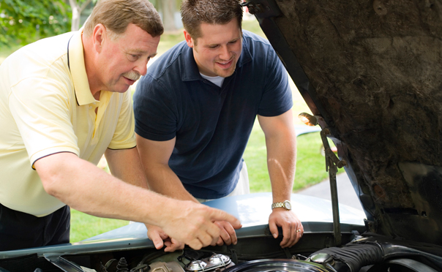
Examples:
John’s driving his father’s car while his own car is in the workshop.

Slide 9
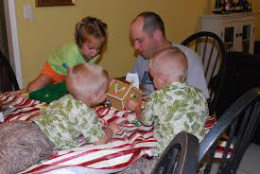
They’re temporarily living with his Uncle Fred. They’ll stay there until they find an apartment.

Slide 10
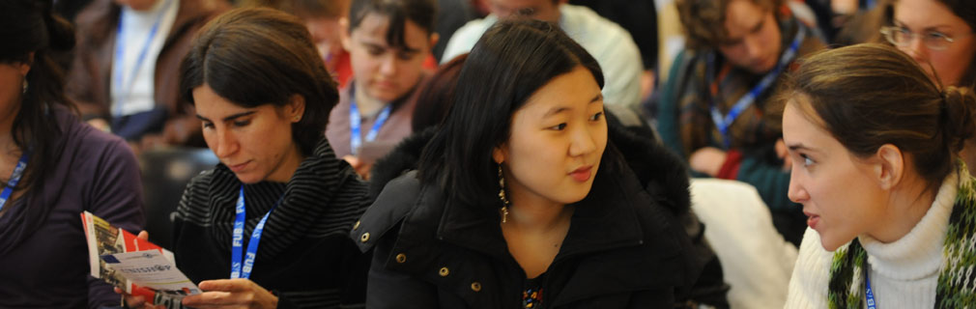
I’m studying in Berlin this year

Slide 11

The time, in the previous examples, may vary, for example: a week, a month, a year, or even longer. What’s important is that the action or situation is not expected to be permanent.

Slide 12

Affirmative: Subject + am/ is/ are + verb -ing
Negative: Subject + am not/ is not/ are not + verb -ing
Interrogative: Am/ Is/ Are + subject + verb –ing ?

Slide 13
Conclusions:
Temporary actions are those which are not expected to continue for a long time, that’s why we use them to talk about things happening at the moment of speaking. And to express these kind of ideas, it is posible to use the Present Continuous tense.

Slide 14
Bibliografía sugerida para el tema:
Paul Davies, M. G. (2014). Make it real! Professional. Pachuca: UAEH University Press.
Redston, C. Cunningham, G. (2005). Face2Face Elementary Student’s Book. Cambridge, London. Cambridge University Press.
Redston, C. Cunningham, G. (2005). Face2Face Pre-Intermediate Student’s Book. Cambridge, London. Cambridge University Press.

