Slide 1
A Market for Sovereign Control?
Blocher & Gulati

Slide 2
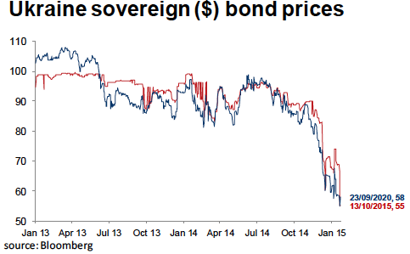

Slide 3
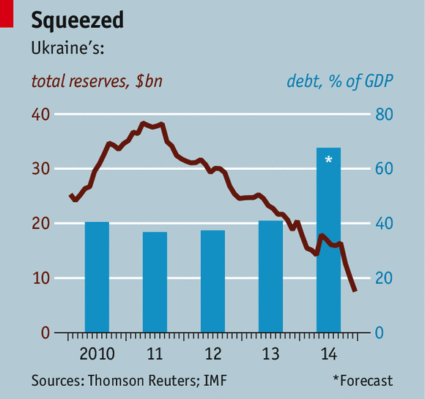

Slide 4
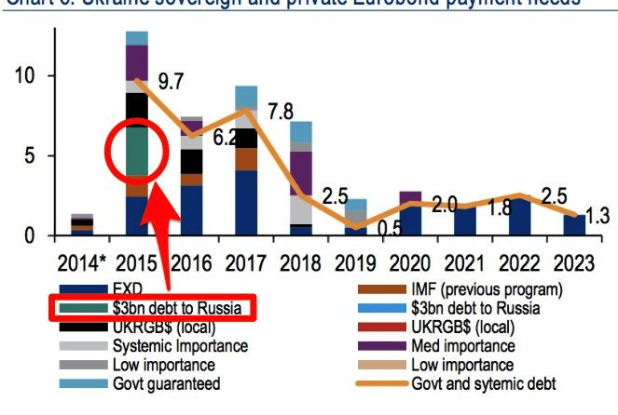
Ukraine Needs
$15 billion in 2015 alone
Ordinarily, it would negotiate a extension of maturities.

Slide 5
Ukraine’s Debt Dilemma
It needs $15-20 billion from the IMF-EU
They are reluctant to give it for two reasons – (1) Ukraine’s debt is unsustainable (they won’t get repaid) and (2) the money is going to Russia (looks bad, smells bad)
Ukraine has to solve that problem – reduce debt stock and improve the optics
Other creditors (Franklin Templeton) don’t want to subsidize Russia either

Slide 6
To Reduce the Debt Stock
You have to get the creditors to agree to take less
But of the 12-13 billion coming due in 2015, roughly 6 billion is probably Russian
Other creditors are not going to take a cut “voluntarily” unless Russia takes a hit
And Russia cannot be crammed down on at least $3bn b/c it owns 100% of a bond

Slide 7
Question is: What to do about Russian Creditors?
Their contracts are under English law (US dollars)
They are going to try to accelerate and trigger cross defaults on all my debt if I don’t pay up
So, I have to give the English judge a reason why he should not allow the triggers
What about if I say “They took my stuff (Crimea); and therefore I won’t pay until they pay me”

Slide 8
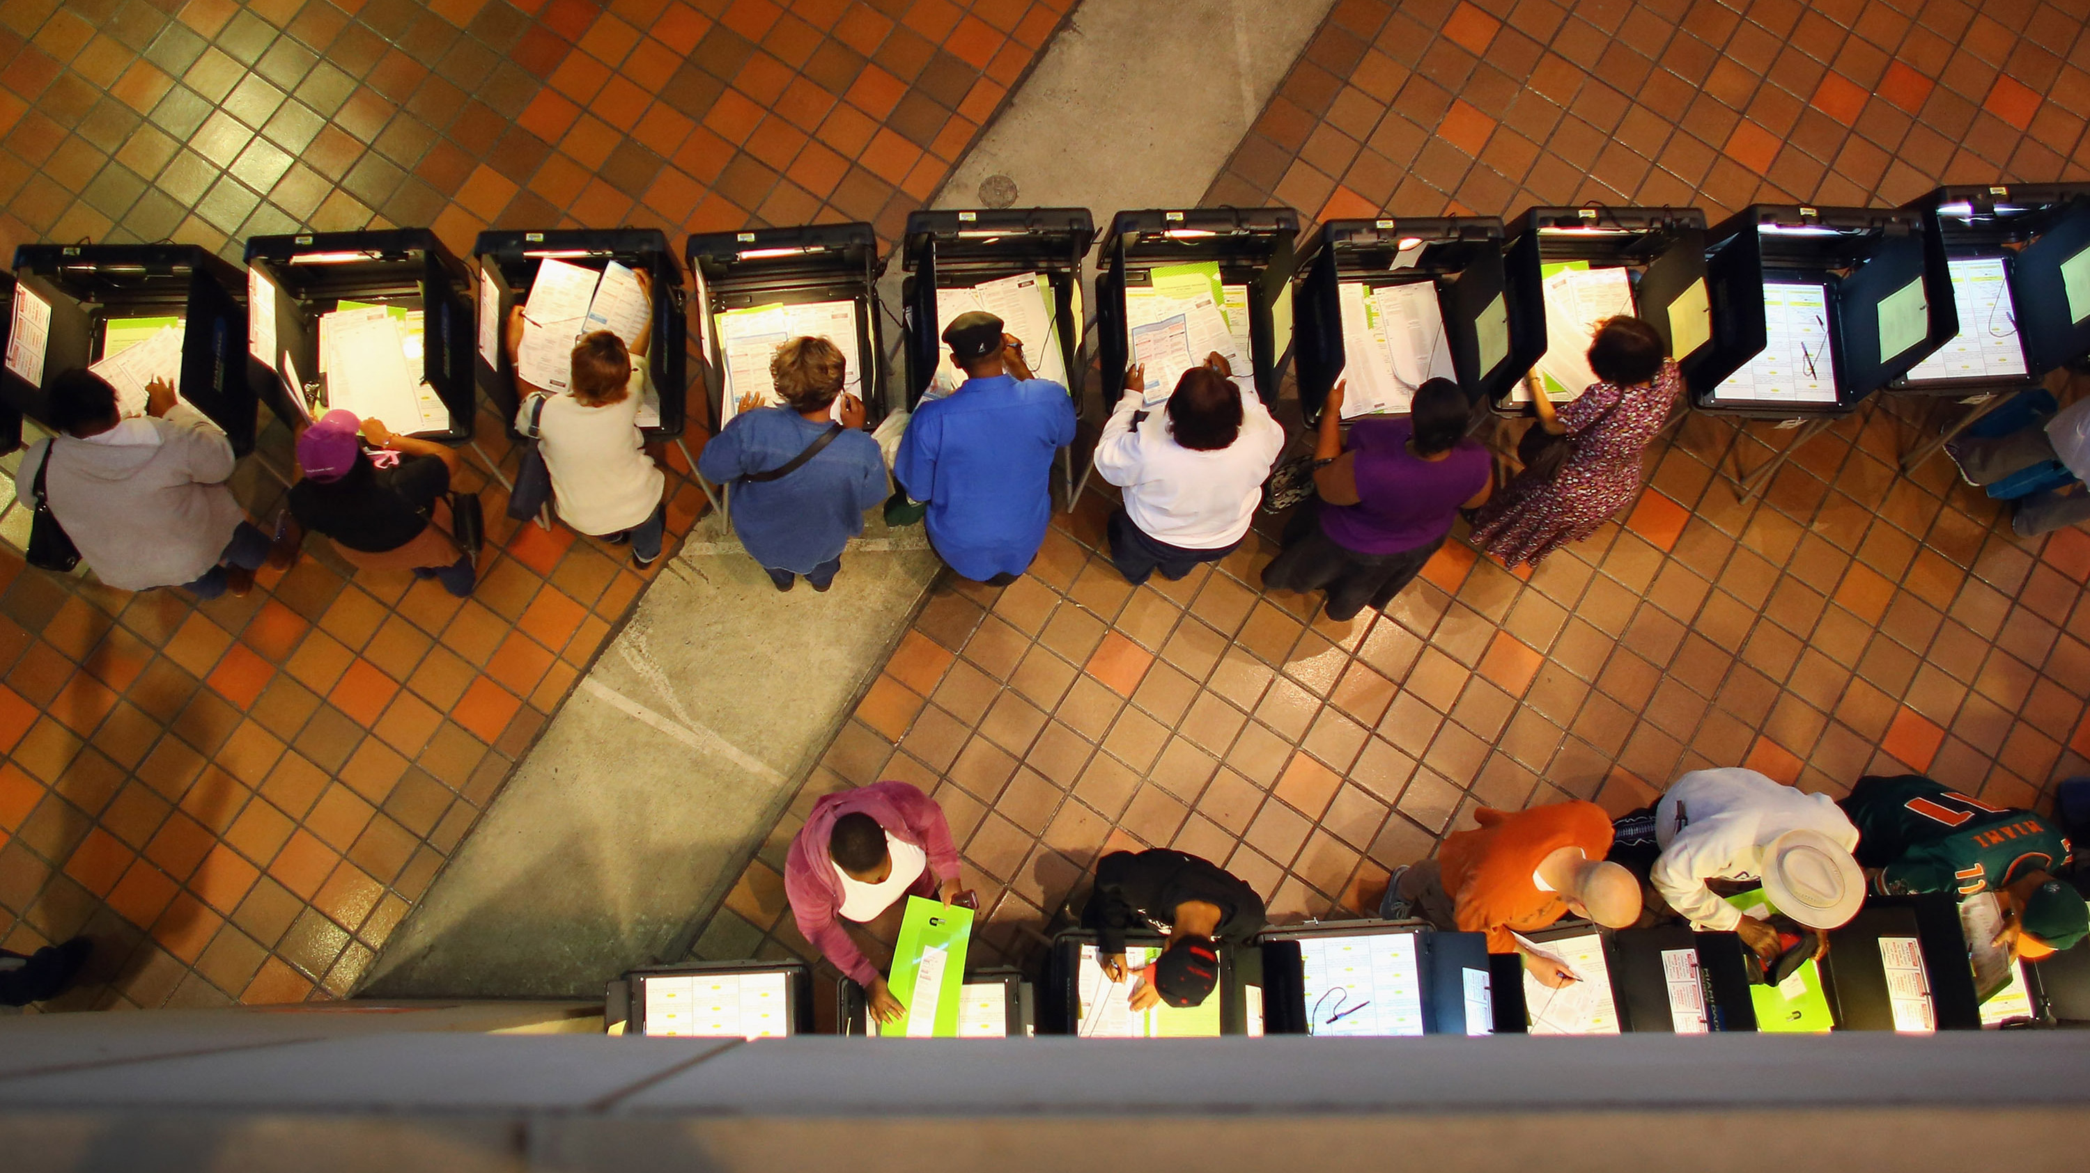
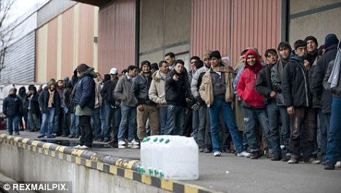
Changing Sovereign Control

Slide 9
Two Rules of International Law
Traditional Rule
Modern Principle
Countries can transfer or sell regions and their people.
  Mostly stopped by 1900
Some states (and authorities, including Vattel) seek regional approval, but it isn’t required.
The idea of self-determination has increasing support.
Remedial secession—free exit—may be available in situations of severe humanitarian abuse.

Slide 10
The Gap Between “Sale” and “Free Exit”?
The UN has said that “all peoples” have a right of self determination, but also that nations have a right to “territorial integrity.”
  How can these be reconciled?
Classification depends on governance—countries that seriously oppress people lose the right to be sovereign over them.
  What about situations of “mild” oppression?

Slide 11
The “Market” Solution
Some regions are in the wrong countries – they would be better off governed by different leaders.
Such regions should be able to:
  1. search for better partners
  2. exit under conditions where they are being treated badly, even if not yet suffering widespread humanitarian abuse

Slide 12
 | Category 1 | Category 2 | Category 3
State of Governance | Good (strong default rule) | Lacking equal rights or representation | Oppressive or genocidal
Who “Owns” Sovereignty | Parent Nation | Parent Nation | Region
Who Must Approve Transfer | Parent Nation and Region | Region | Region
Legal Principle | Territorial sovereignty | Combination of both | Remedial secession
Example | UK and Scotland | Ukraine and Crimea | Indonesia and East Timor
Underlined text = change to current rules

Slide 13
Some Benefits and Costs
Benefits
Costs
Sovereigns would have an incentive to treat regions better, since they might otherwise leave.
Regions would not need to wait until widespread humanitarian abuses to exit.
Instability
Threat of colonialism
Commodification of people
Impossible “practical” challenges

Slide 14
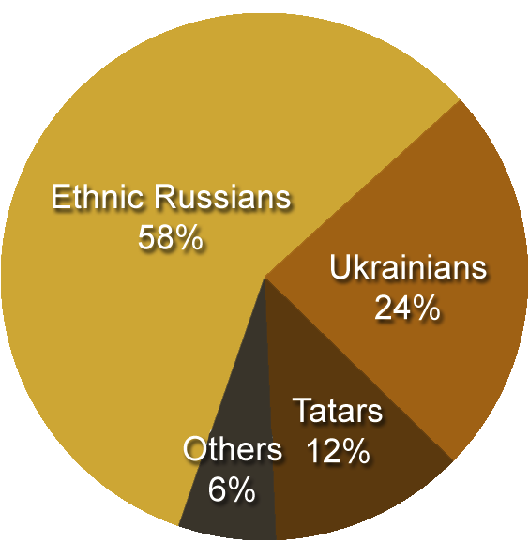
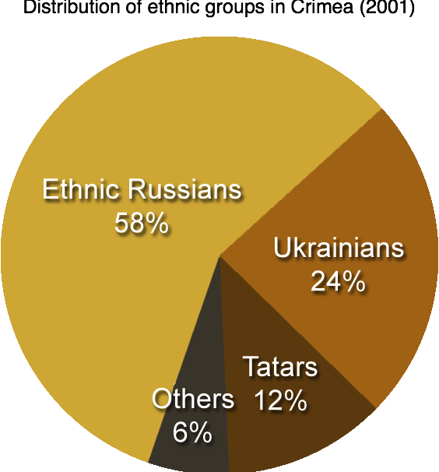

Slide 15
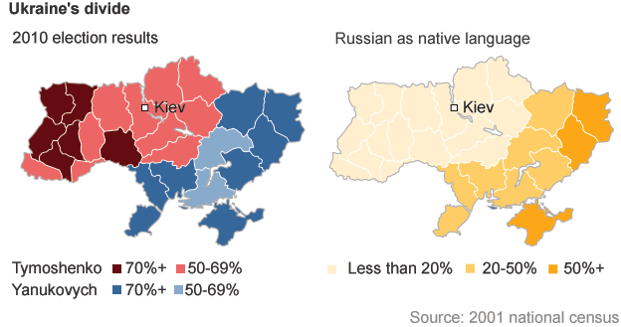

Slide 16
Our Proposal for Ukraine
Ukraine cannot get Crimea back, but is owed a set off on the Russian claims
Why? Because Russia took its territory
Key Element: This will come up in an English court, because the debt claim in under English law

